Slide 1
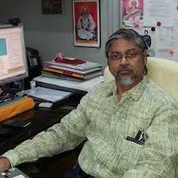
Sankar Kumar Nath
Sankar Kumar Nath is a geophysicist, seismologist and a senior professor at the Indian Institute of Technology Kharagpur.

Slide 2
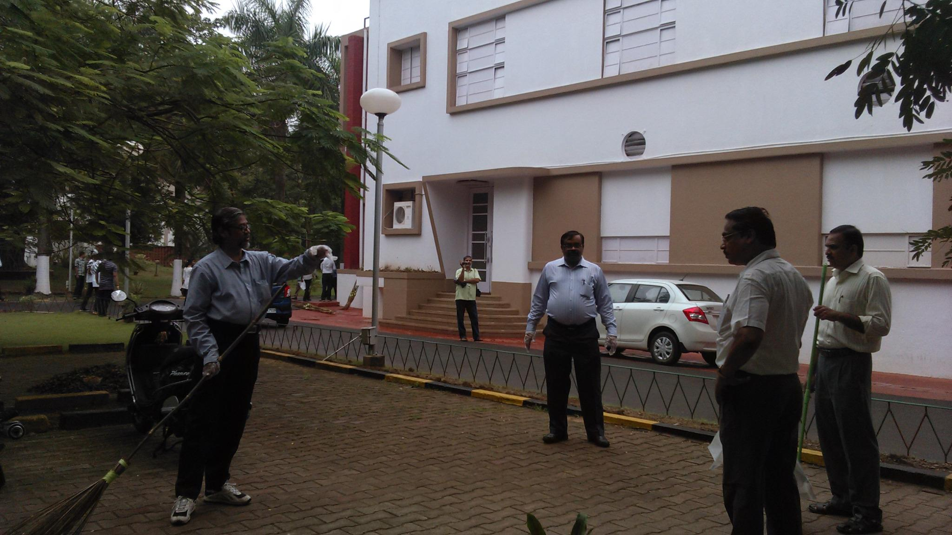
Biography
S.
K.

Slide 3
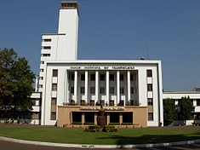
Legacy
Nath is known to have studied the seismic activities in the Himalayan region including the earthquakes in Nepal in April and May 2015.

Slide 4

Awards and honors
S.
K.
Nath received the National Mineral Award of the Ministry of Mines in 1999.

Slide 5

Selected bibliography
Sankar Kumar Nath, Hari Pada Patra (1999).
Schlumberger Geoelectric Sounding in Gro.
CRC Press.
p.
160.
ISBN 978-9054107897.

Slide 6
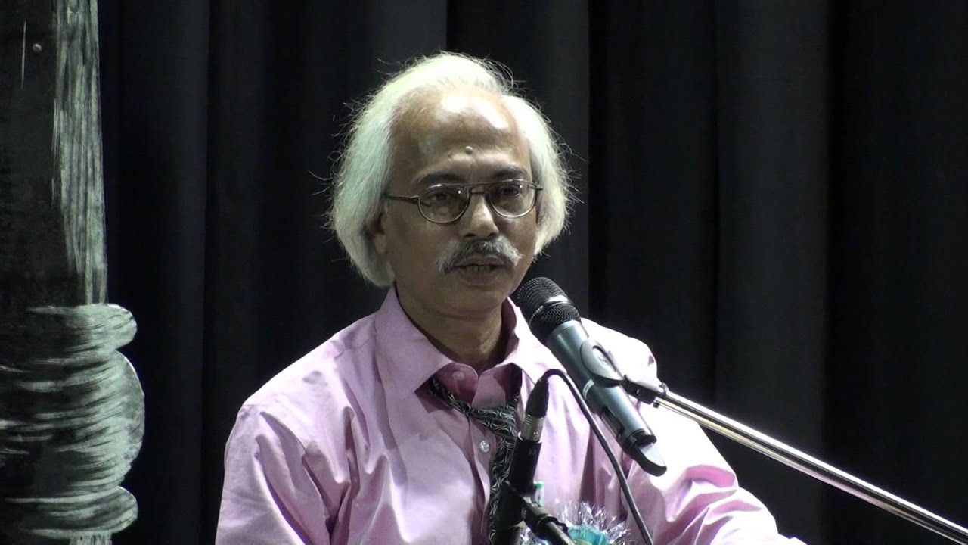
Notes

